Slide 1


White Label Software for Telecommunications Providers.
&
V2.0

Slide 2
What we do
+
ActivePort’s white label software platform
SD-WAN
Network Functions Virtualisation (NFV)
Network Orchestration
API Integration
Compute
Any X86 Device
Add virtualised Firewalls to your X86 bonders or aggregators
Control routers, switches and firewalls with Rest API remotely
Self Service ordering and tickets
30% faster using local AMD V520 GPUs
Live Failover & bandwidth bonding
Carrier API’s for pricing, ordering, provisioning and faults
Deploy services quicker & with lower cost
No cost to download
Packet based encryption & load balancing
Get real time visibility of devices, circuits & cloud
OSS & BSS APIs for CRM, billing & inventory etc
We use AWS API’s to make migration easy
Disaggregated SASE - Add your choice of Firewall NFV
Resolve faults faster with fewer customer escalations
Eg: Autotask, ConnectWise, ServiceNow, ZenDesk
New AMD V620 is 4 x faster again.
Automated delivery of Cloud Services
Manage everything from a single pane of glass

Slide 3
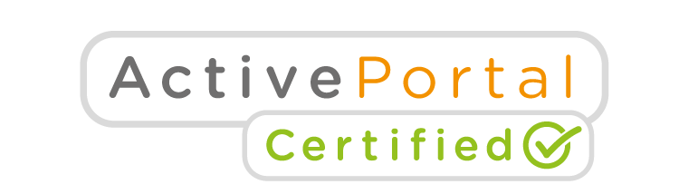
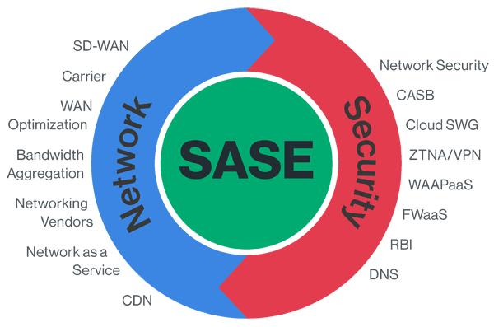
Disaggregated SASE
Mikrotik CHR | Sophos XG
Juniper vSRX | vYOS
FortiGate VM | Sonicwall NSv
WatchGuard FireBox V | PaloAlto VM
pfSense | Barracuda CloudGen Vx
Secure your customer to the internet edge in a single pane of glass
Add your choice of virtual firewall (NFV) to your SD-WAN bonder or aggregator.
Provide a complete solution to your customers using the same x86 devices (Bonder and Aggregators)
Centralised firewalls reduce the number of entry points to your customers network and are easier to deploy, at lower license cost.
If your customers requires Tunnel Bypass we support site based virtual firewalls.

Slide 4

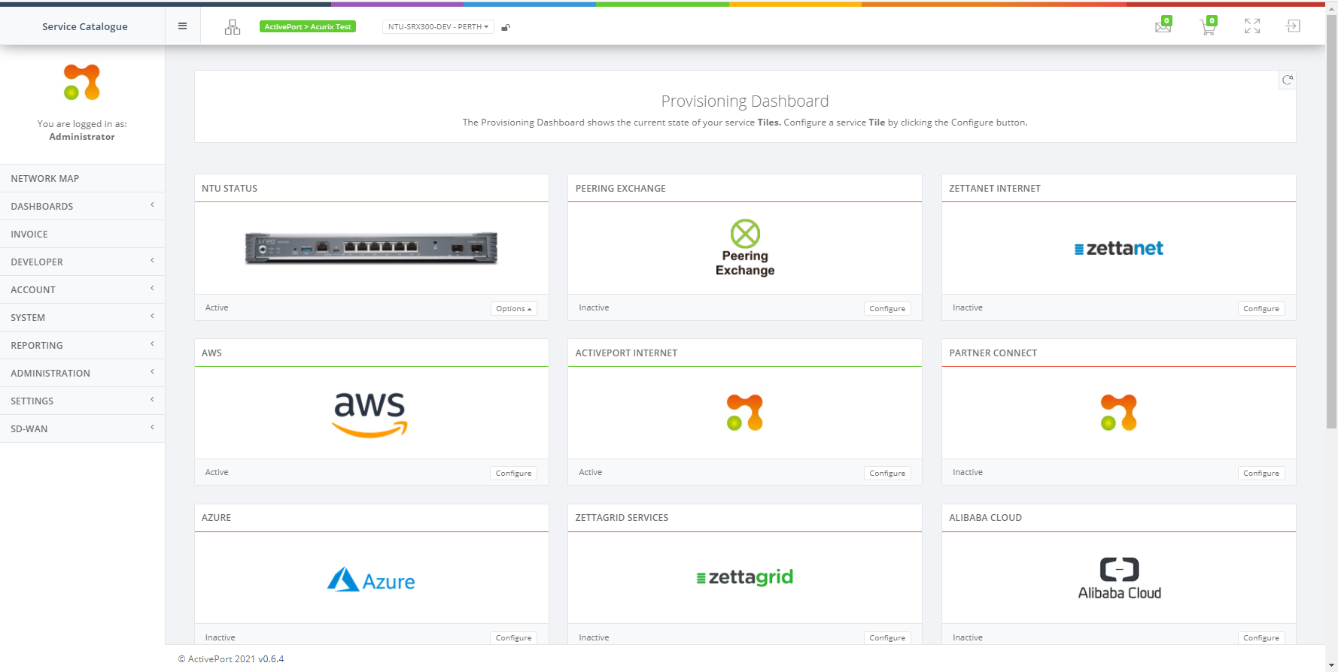
Single Pane of Glass
Deliver an end to end SDN for your customer & reduce your operational overheads
Can configure and deploy Turnium services directly from ActivePortal.
Combine the ability to manage, control & troubleshoot your customers traditional switches and routers
Build a disaggregated SASE solution based on your customers needs, not what a single vendor provides.
Link it all together with a Cloud-Native SD-WAN
Integrate your CRM, Ticketing, Inventory and Billing Systems into your UI to optimise your operational costs and reduce development overheads.

Slide 5
Deploy devices to the field quicker & with lower cost.
Many service providers have their most senior level 3 engineers configure every device.
Template based provisioning is quicker and can be done by level 1 engineers.
Template based device configuration
  Use or modify our templates or create your own.
  Level 3 engineer sets up template once, and hands to level 1 resource.
  Reduces time spent setting up your devices and lowers cost
  Ensures consistent configuration every time
Remote configuration changes
  New templates can be pushed to device remotely
  Fewer site visits and lower cost
Works with most vendors API capable hardware and all providers access circuits

Slide 6
Getting real time visibility of devices, circuits & cloud
Visibility of network devices and circuits is a challenge, even for the largest carriers.
Combining Orchestration and SD-WAN you have real time visibility of the customers network
Without a site visit you can diagnose the source of a problem on the local network, the carrier access or cloud interconnect.
  Dynamically monitor the CPE across both the circuit and TVC.
  Report on QoS and monitor real-time web-traffic, voice data, video consumption per device
  For routers
    View Sys log, Port utilisation, CPU & memory load, Latency & Jitter
  For SD-WAN / SD-Internet
    View Sys log, Tunnel & Leg performance, QoS & Traffic summary
    View prevented downtime report to show customers the benefit of failover services.

Slide 7
Resolve faults faster with fewer customer escalations
Customers are normally the first to notify your helpdesk of outages or speed issues.
Automatic failover solutions should prevent outages, but many require manual intervention or take so long that voice, video and critical application sessions are dropped.
Event notifications and remoting testing help fix faults faster, Live failover means customers are unaware and still operating.
  Event notifications are reported to your team so they can react fast.
  Remote Link tuning capability to fix issues with SD-WAN / SD-internet circuits & TVC
  Provisioning DOA cases fixed faster using the SDN failover link to run level 1 checks.
  Complete level 1 fault checks remotely without a site visit, run and submit the output as part of the carrier helpdesk case.
    SYSLOG – live and historical
    Port Status - test in real time
    Link - see any latency and jitter
    Isolation test - shut down all other ports on the device
    Speed test - to public internet including ping and trace route.

Slide 8
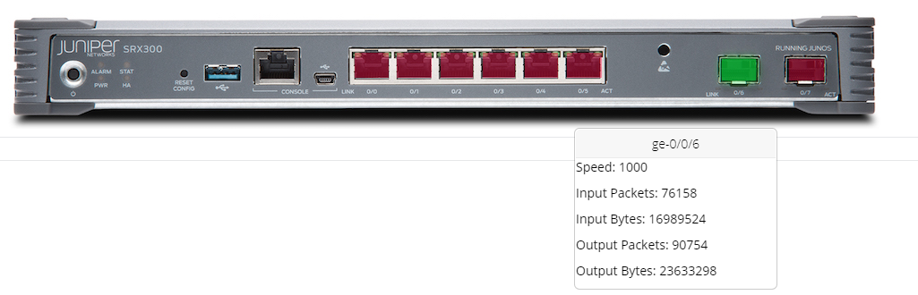
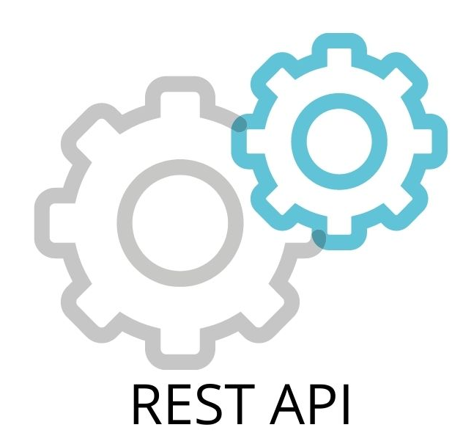
Orchestration & API Development
Ports in-use show as green
Remote control of network software and hardware
Customer requested and developed
Juniper orchestration
CISCO IOS orchestration
New life for CISCO 4300s & 4400s – use KVM to emulate X86 for SD-WAN
Microtik orchestration & CAPsMAN AP controller for WiFi
We develop
Carrier APIs (Pricing, Ordering, Provisioning & Faults) in multiple countries
Application APIs
  Business Management software - Autotask, ConnectWise, ServiceNow, ZenDesk etc
  API into ticketing and billing platforms.

Slide 9
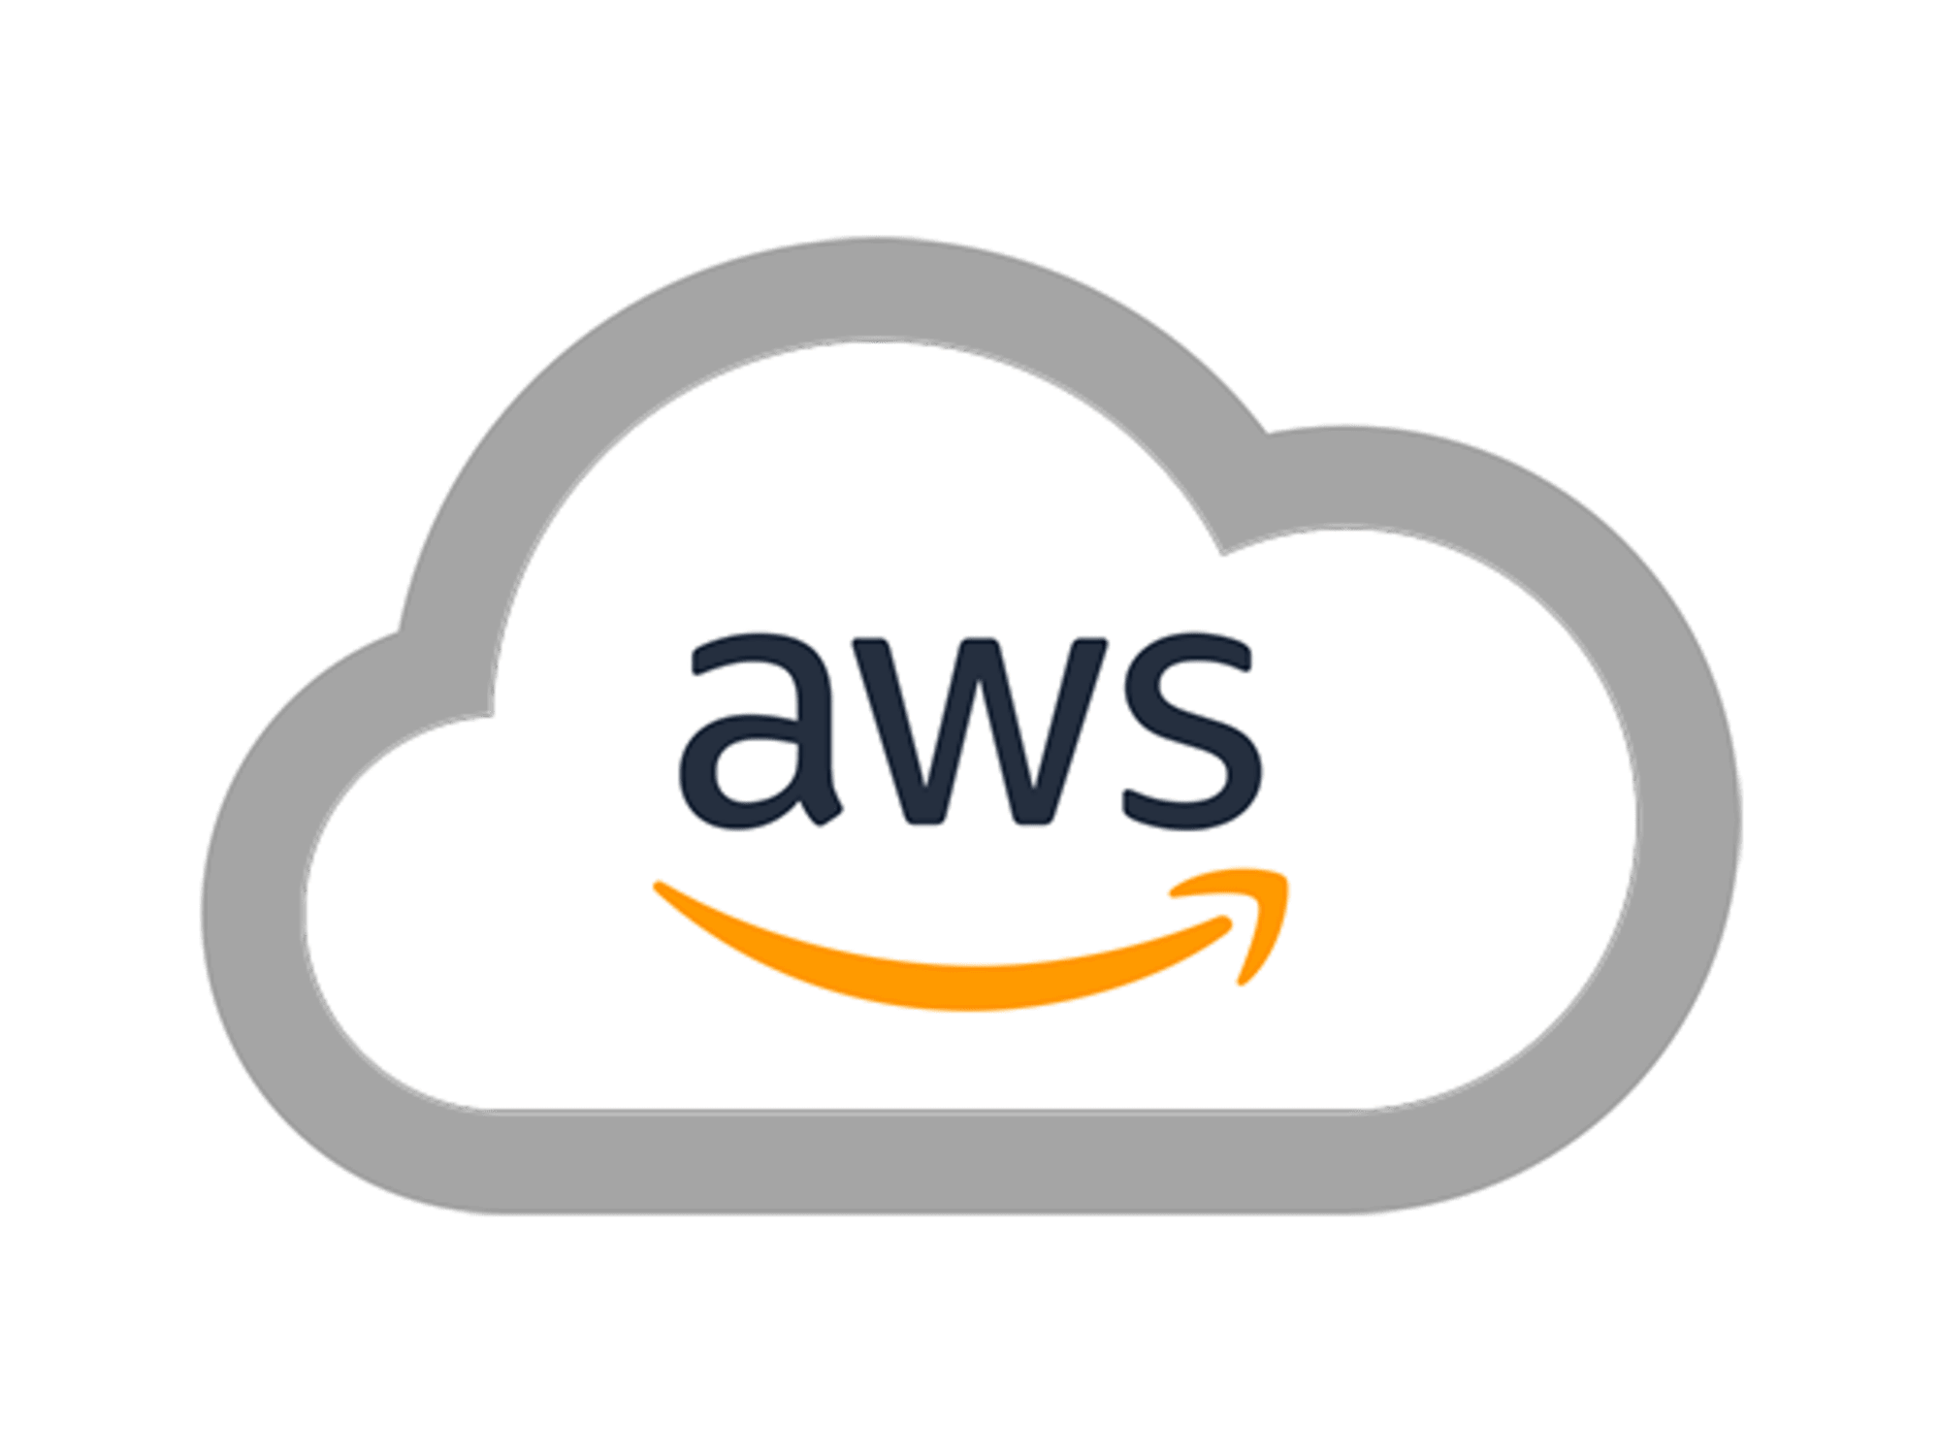

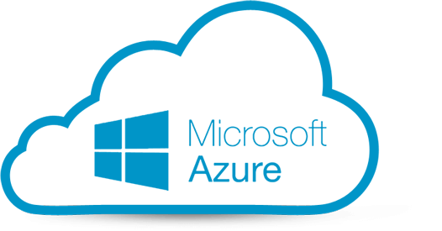
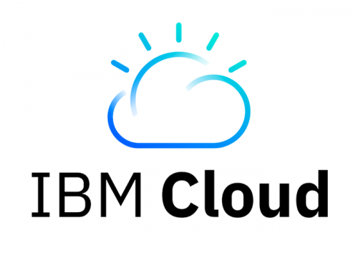
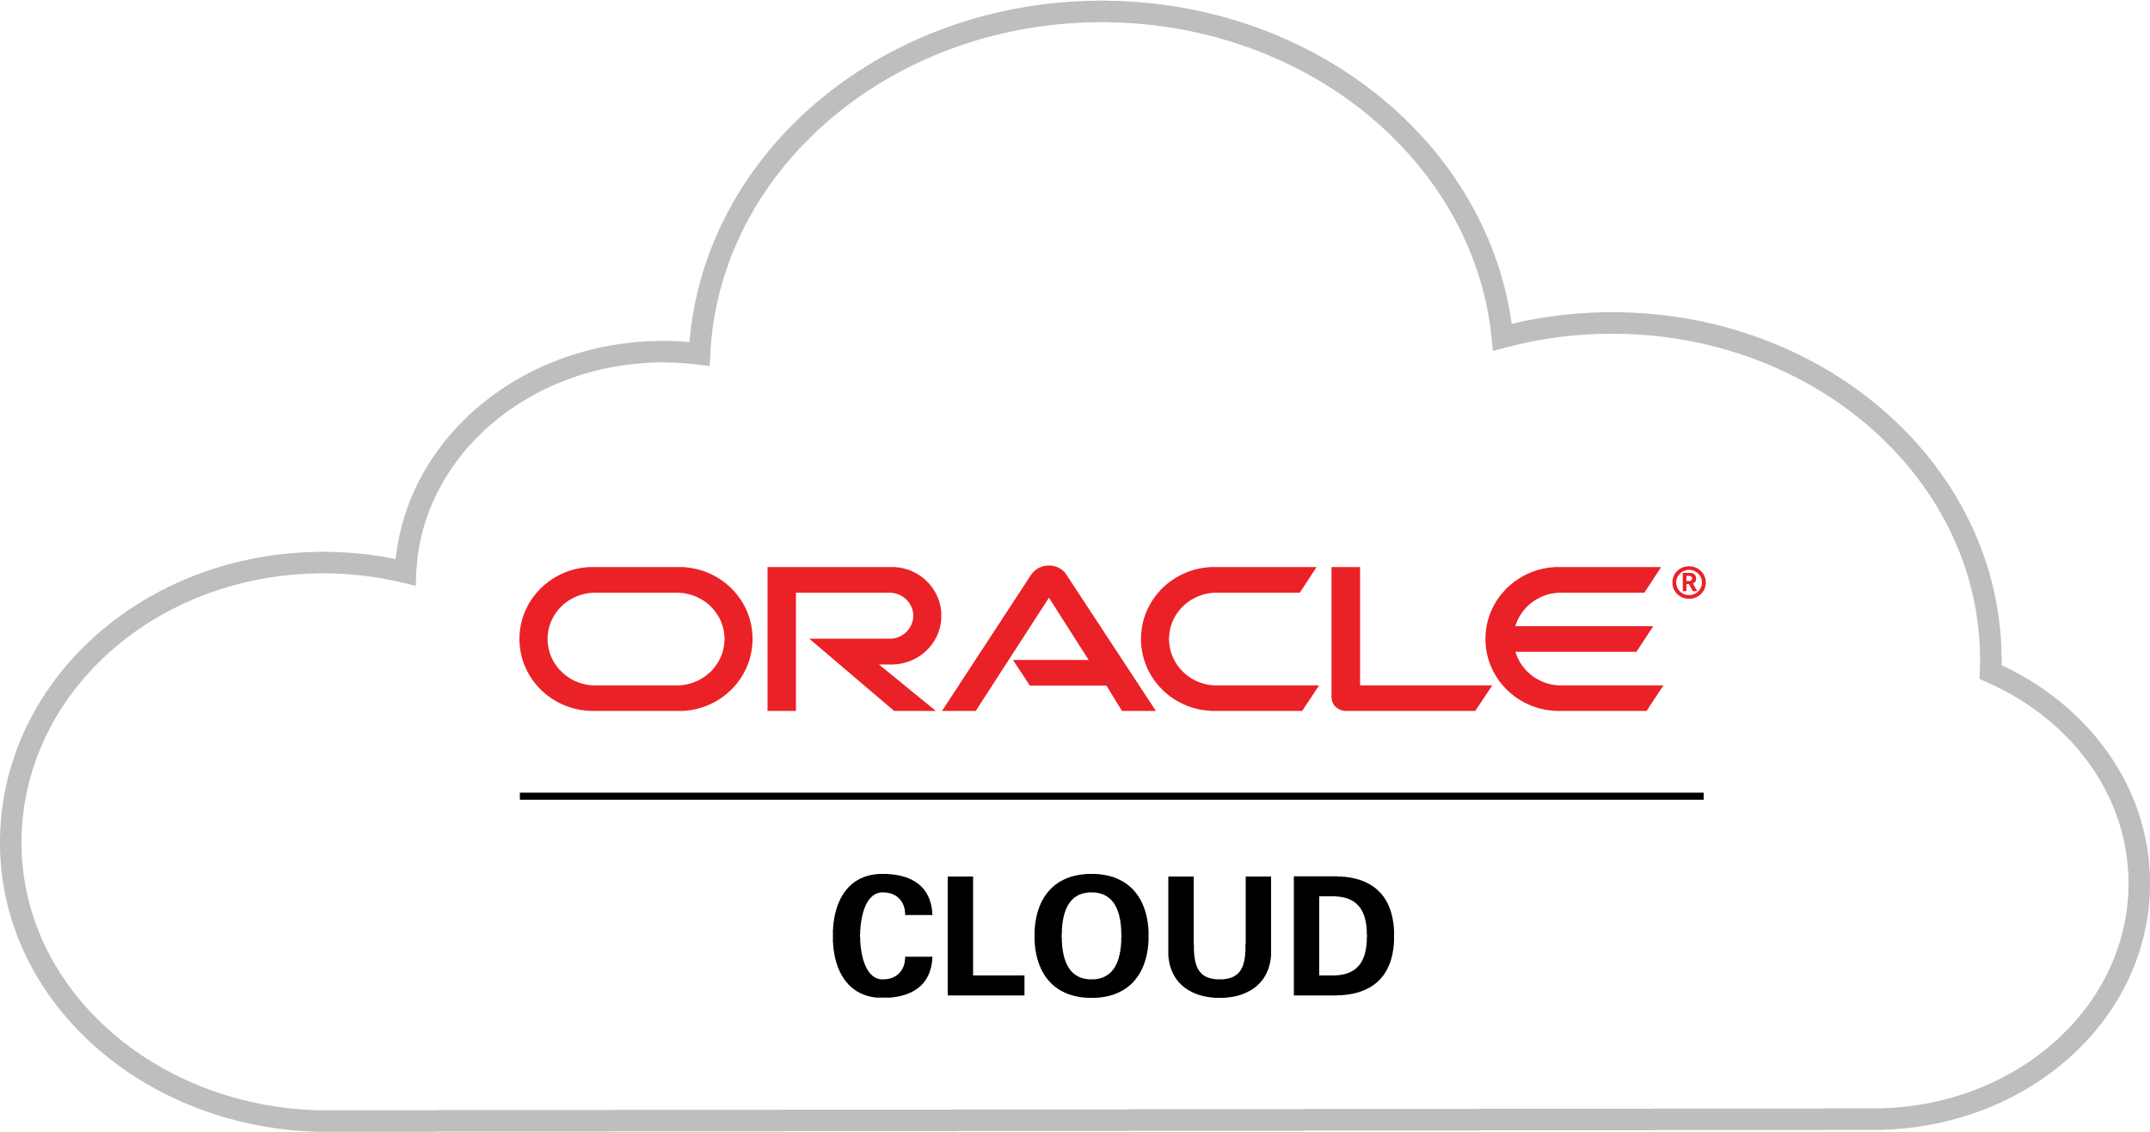
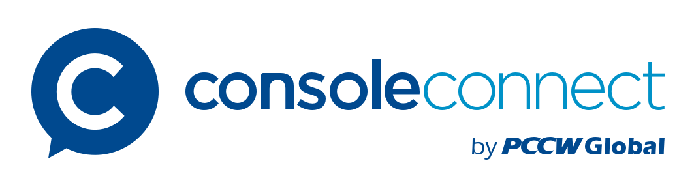

Orchestration - Automated delivery of cloud services
All the way to the customer edge: AWS, Azure, Google, IBM Cloud, Oracle Cloud etc
Cloud providers and eco-system partners only deliver to Data Centres.
ActivePort automates the delivery of cloud services to your customers edge.
  Saves you the time and cost of manual configuration and delivery.
  In real-time you can price, select and provision cloud services directly from:
  BYO account, we orchestrate:
Others

Slide 10
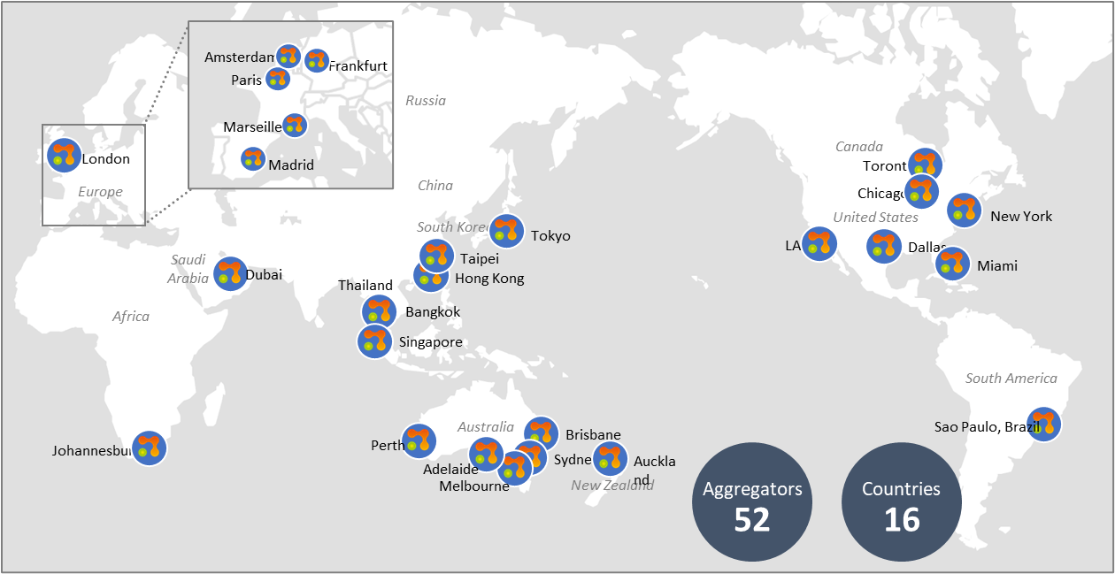
Global Partner Network
Extend your network reach to where your customers have offices
Extend your network reach beyond your physical footprint
Purchase and provision links from our partners in 16 countries across 52 POPs
Customers can use internet for local loop connection to our closest aggregation point
Once connected to the aggregator the customer edge device can be added to your network in real time.

